Slide 1
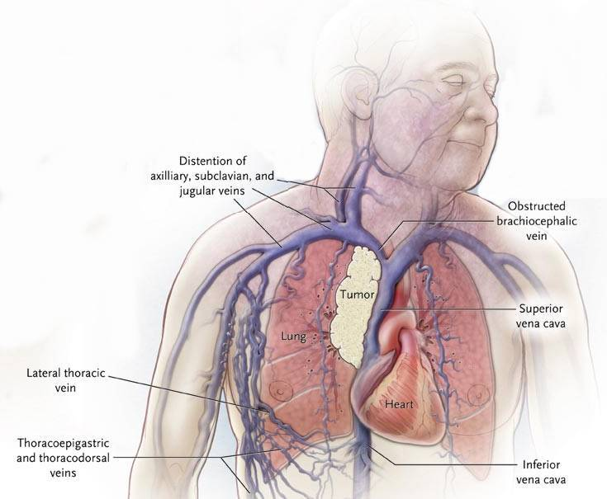
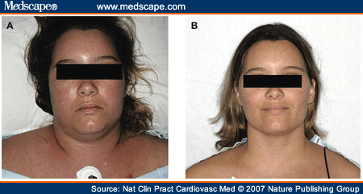
Interesting Case
Dx: Anterior Mediastinal Mass with Superior Venacava Obstruction
Op : Median Sternotomy with tumor removal
ร.อ.ชาติชาย/อ.ณัฐธพงษ์

Slide 2
Case
Case ผู้ป่วยหญิง 31 ปี
Chief complaint : หน้าบวมมากขึ้น 2 สัปดาห์

Slide 3
R 1 ซักประวัติเพิ่มเติม

Slide 4
Case
Case ผู้ป่วยหญิง 31 ปี
Chief complaint : หน้าบวมมากขึ้น 2 สัปดาห์
Present illness
2 สัปดาห์มีหน้าบวมมากขึ้น แขน 2 ข้าง บวมมากขึ้น มีหายใจเหนื่อยขึ้น ปัสสาวะออกปกติ ไม่มีขาบวม เท้าบวม
3 วันหน้าบวมมากขึ้น สังเกตเห็นเส้นเลือดฝอยบริเวณใต้ราวนมปริมาณมาก เวลาพูดมีเสียงแหบมากขึ้น หายใจเหนื่อยขึ้น เวลานอนราบแล้วมีหายใจเหนื่อยขึ้น บางครั้งหายใจมีเสียงวิ๊ด

Slide 5
Hx เพิ่มเติม
หายใจเหนื่อยมากขึ้น เดิม FC 1-> FC 3
นอนราบไม่ได้ เวลานอนรายจะหายใจมีเสียงวี๊ดบางครั้ง ลุกขึ้นมานั่ง อาการเหนื่อยจะลดลงชัดเจน
ไม่มีเจ็บหน้าอก ไม่มีประวัติวูบหมดสติ
ไม่มีหนังตาตก ไม่มีกลืนลำบาก ไม่มีกล้ามเนื้ออ่อนแรง

Slide 6
Past history
Underlying disease
DM type 1
Lantus 12 U sc ac,
Novorapid 2-3-2 U sc
Last HbA1C 7.5%
Neurogenic bladder from DM type 1
Optic disc atrophy
Bipolar disorder
Sertraline(50) 1x1 opc
Risperidone (1) 1xhs

Slide 7
Hx เพิ่มเติม
No drug allergy
No Hx smoking
No Hx alcohol drinking
No Hx previous Sx
No Hx chemotherapy/radiotherapy

Slide 8
History focuses on
Local symptoms related to the size of the tumor and its effects on adjacent intrathoracic organs
chest pain, dyspnea, dysphagia, syncopal
Systemic symptoms due to paraneoplastic syndromes
Thymic mass secreting antiacetylcholine receptor antibodies, causing myasthenia gravis

Slide 9
R 1 Physical examination

Slide 10
Physical Examination
Vital signs at ward
BP 118/68mmHg PR 74 BPM
BT 36.7°C RR 22 breaths /min
O₂sat 96% room air
BW 57 kg, Height 150 cm (BMI 25.33 kg/m²)
GA : A Thai female, good consciousness, well co-operated, facial swelling, no facial plethora

Slide 11
Physical Examination
HEENT : not pale, no jaundice, fullness of supraclavicular area
Lung : trachea in midline
ท่านั่ง clear, equal breath sound both lungs
ท่านอนหงาย Inspiratory & expiratory wheezing Lt.
Heart: pulse full & regular ,no heaving, no thrill, normal S₁&S₂, no murmurs
Chest wall : superficial vein dilatation
Abdomen : soft, not tender, liver & spleen can not palpable
Extremities : Lt.arm swelling no pitting edema

Slide 12
Physical Examination
Neurological examination :
E₄M₆V₅
No facial palsy
Full EOM, Pupil 2 mm RTLBE
No papilledema
Sensory intact
Motor grade V/V
DTR 2+ all

Slide 13
Physical Examination
Airway examination :
Limit neck of motion : No
Thyromental distance > 6 cm
Mouth opening > 3 cm
Upper lip bite test : grade 1
Prominent incisor : No
Mallampati grade : grade 2

Slide 14
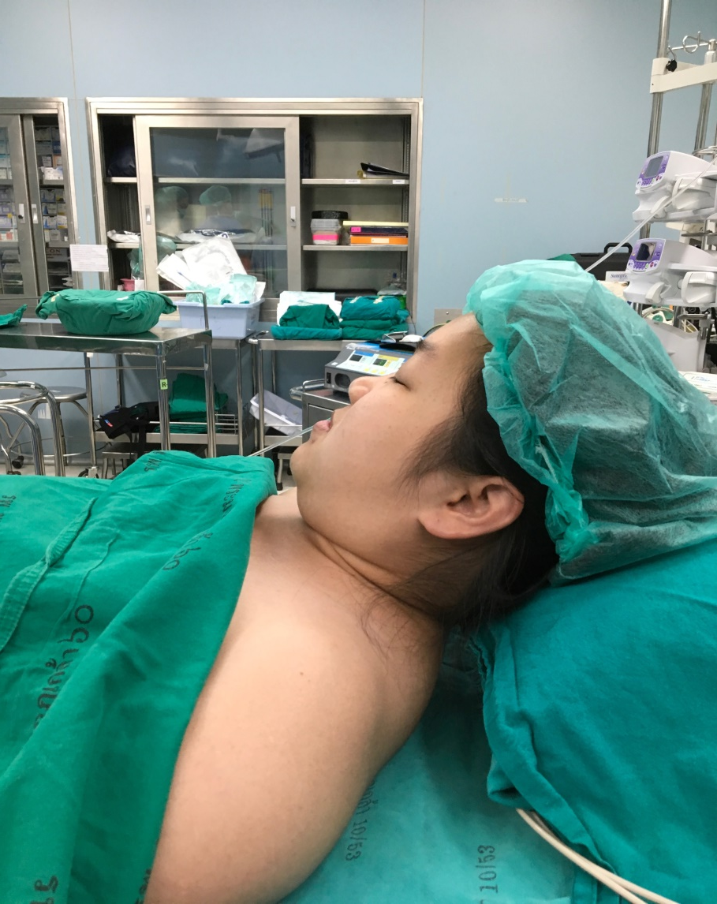
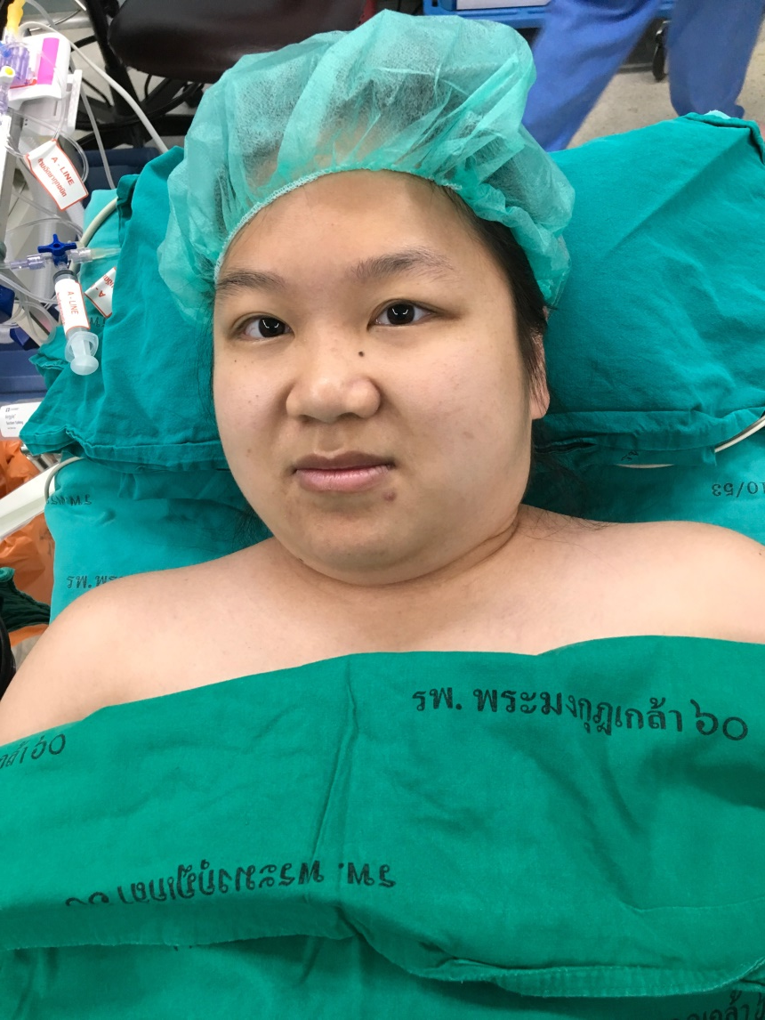

Slide 15
Physical examination focuses on
signs associated with mass effects
Tachypnea, dyspnea,
Hoarseness -> vocal cord edema
Cough, stridor
Facial and/or upper extremity edema -> SVC syndrome
Hypotension -> cardiac compression

Slide 16
R 1 Investigation + เหตุผล

Slide 17
Investigation
CBC: Hb 12 gm/dl, Hct 35.9%, Platelet 372,000/mm³
Coagulogram: PT 12.7/0.97 ,aPTT 22.1/0.83 ,TT 14.2/1.13
Electrolytes: Na 139, K 4.12, Cl 104.2, CO₂ 20.4
BS: 135 mg/dL
BUN: 9.2 mg/dL Cr:0.62mg/dL eGFR: 114
TFT : normal
CXR : Anterior mediastinal mass
EKG : NSR rate 83/min ,no ST-T change

Slide 18
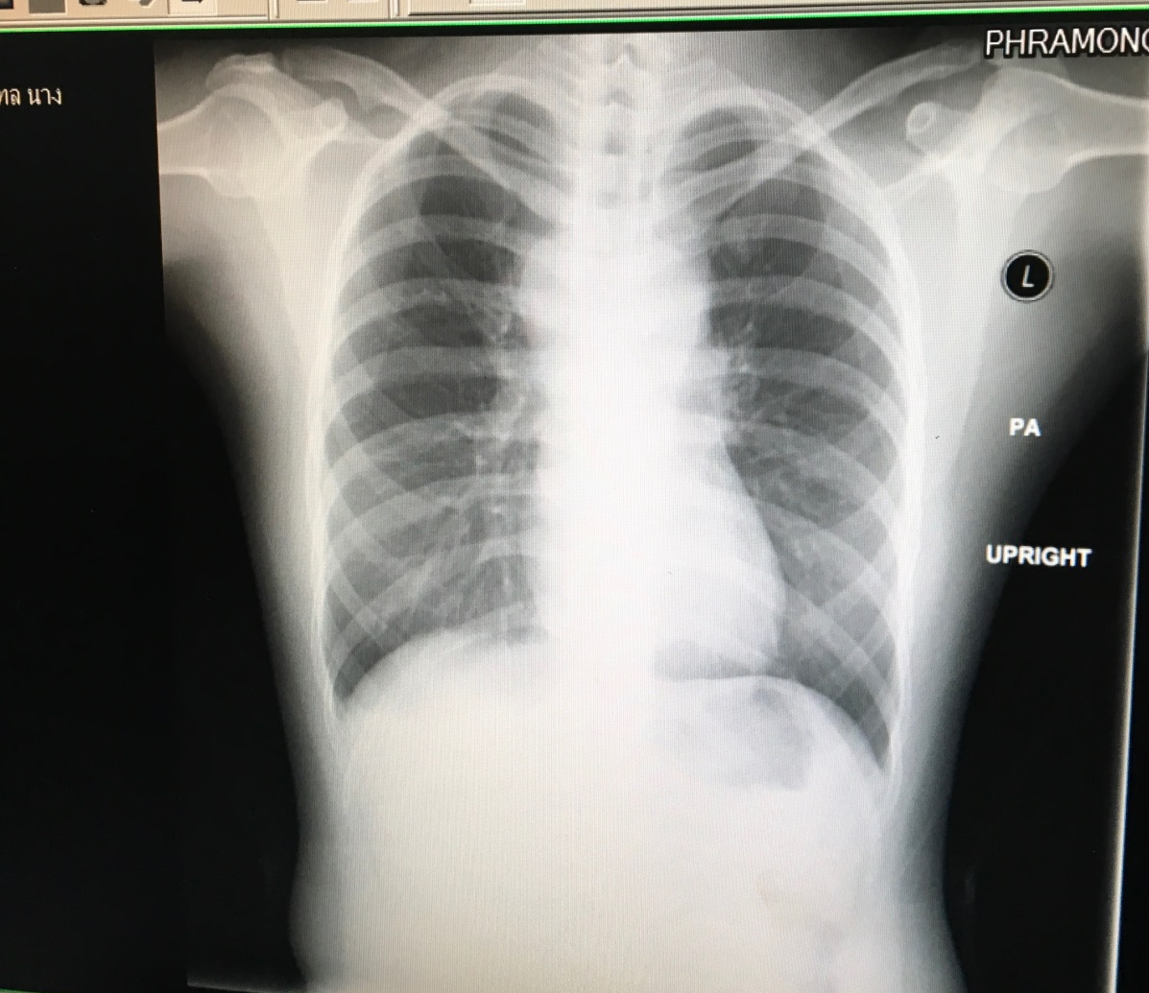
CXR

Slide 19
Investigation
CT Chest
Homozygous enhancing well defined mass like lesion at anterior mediastinal size 3.7 x 8.4 x 6.5 cm with compression SVC at suprazygos level and obliterate bilateral brachiocephalic vein, encase ascending aorta, arch and left common carotid artery

Slide 20
R2 Problem list

Slide 21
Problem list
Anterior mediastinal mass c SVC obstruction
DM c neurogenic bladder
Optic disc atrophy
Bipolar disorder

Slide 22
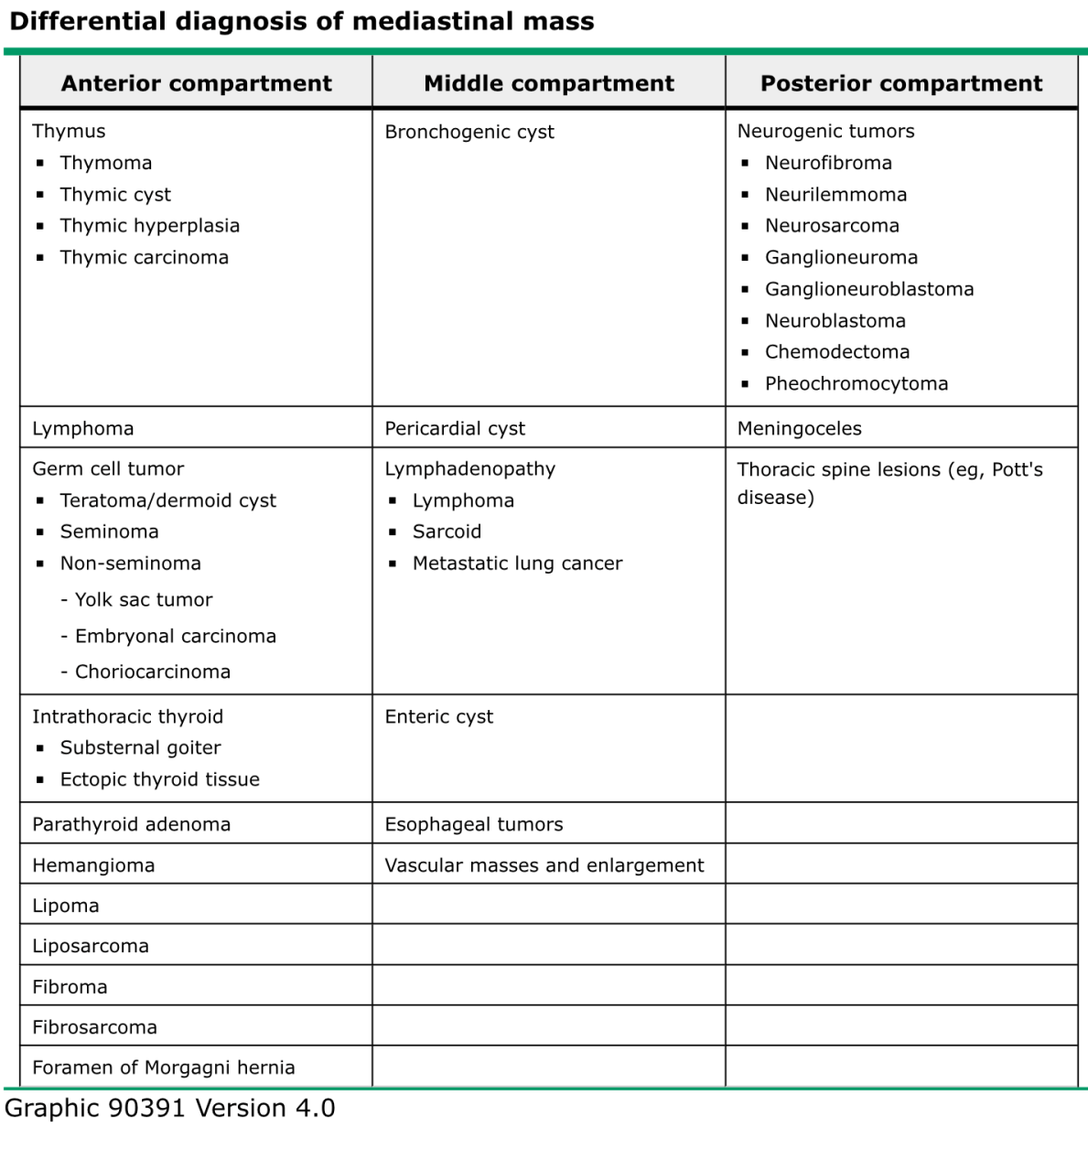
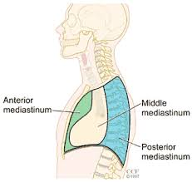
Anterior Mediastinal Mass
5T
Thymus
Thyroid
Teratoma
T -cell lymphoma
Thoracic aorta

Slide 23
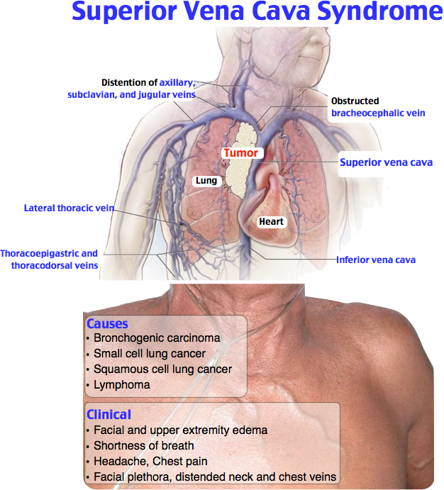
SVC obstruction

Slide 24
ASA classification
ASA III
DM c neurogenic bladder

Slide 25
R3 Preoperative evaluation

Slide 26
Preoperative evaluation
Anterior mediastinal mass with SVC obstruction
Assess risk of airway or respiratory compromise
Mass effect on the airway and lungs
Assess risk of hemodynamic instability & bleeding
Mass effect on major cardiovascular structures and circulation

Slide 27
Anterior Mediastinal Mass DDX?
5T
Thymus –> MG
Thyroid -> TFT
Teratoma
T -cell lymphoma
Thoracic aorta

Slide 28
Preoperative evaluation
Imaging
Assess the relationship of the mediastinal mass to the airway, lungs, heart, and major blood vessels
Not predict after induction period
Pulmonary function tests

Slide 29
Investigation
CT Chest
Homozygous enhancing well defined mass like lesion at anterior mediastinal size 3.7 x 8.4 x 6.5 cm with compression SVC at suprazygos level and obliterate bilateral brachiocephalic vein, encase ascending aorta, arch and left common carotid artery

Slide 30
Preoperative evaluation
Prior Chemotherapy and radiotherapy
Chemotherapy
GI complications -> nausea and vomiting, mucositis, oral ulcerations, dysphagia and odynophagia, and gastritis
Cardiac, pulmonary, or neurotoxic side effects
Radiotherapy
Dry mouth, airway swelling, airway friability
dysphagia, poor oral intake, and dehydration
Scarring and fibrosis of connective -> high airway pressures

Slide 31
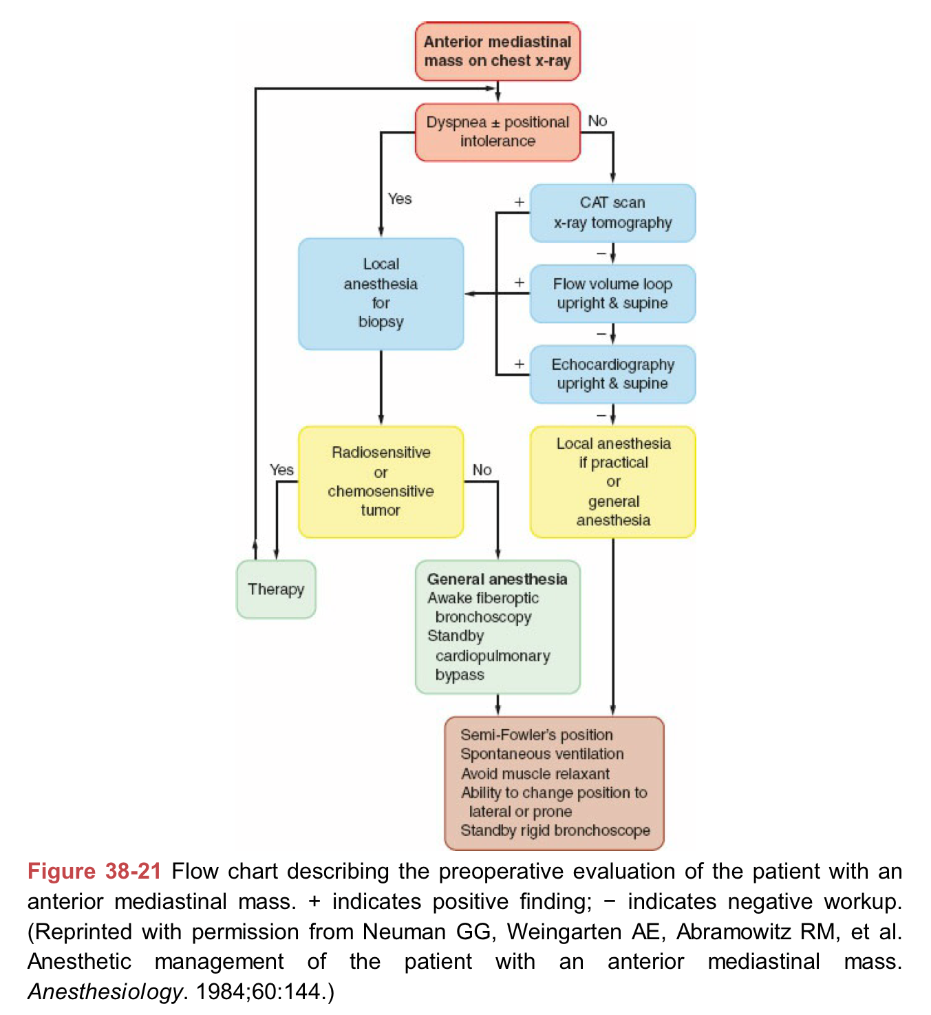

Slide 32
Preoperative evaluation
DM -> Type 1 DM c neurogenic bladder
Baseline glycemic control -> HbA1C 7.5%
Complication/End organ damage
Macrovascular -> CVS, Cerebrovascular, CKD/DN
Microvascular -> DR, Neuropathy, Peripheral vascular disease
Stiff joint syndrome -> Prayer’s sign associate (difficult intubation)
IV Regimen after NPO
GIK
Notes:
Goal
Avioid hypo/hyperglycemia
Prevent ketoacidosis
Balance fluid electrolyte

Slide 33
Preoperative evaluation
Optic disc atrophy
Cause -> Genetic

Slide 34
Preoperative evaluation
Bipolar disorder
Euthymia state
Current medication
Sertraline(50) 1x1 opc
Risperidone (1) 1xhs

Slide 35
R3 Preparation and Premedication

Slide 36
Preparation
Inform consent
NPO
Force air warmer
Warm IV fluid
Large bore IV at lower extremities
Blood component : PRC 2,FFP 2
ICU post op

Slide 37
Preparation
Anterior mediastinal mass with SVC obstruction
Large bore IV at lower extremities
Blood component standby : PRC 2,FFP 2
ICU post operative
Communicate with surgeon
DM type 1
Intraoperative blood glucose monitoring
IV regimen

Slide 38
Preparation
Monitoring
Standard monitoring : NIBP,O₂sat,ETCO_{2 ,}EKG 5 leads, Temperature
Invasive monitoring : -A line
Other : TOF

Slide 39
Premedication
Sertraline
Risperidone
Dexamethasone ?
Anxiolytics ?
Notes:
Anxiolytic -> BZD

Slide 40
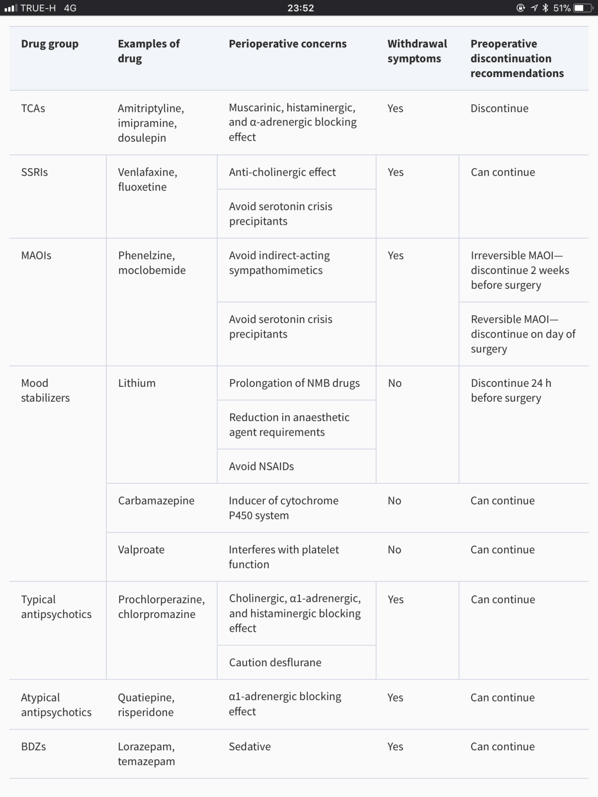
Notes:
SSRI ระวังการให้ยา tramadol pethidine
Serotonin syndrome -> hyperreflexia,agiatation,hyperthermia
Interaction กับ nsaids, warfarin -> เพิ่ม risk bleeding
Withdrawal symptom -> GI upset,dizziness,psychiatric problem
ควร continue ยาต่อ
Atypical antipsychotic -> risperidone
Dopaminergic receptor + serotonin 2A receptor
Extrapyramidal side effect น้อย
เกิด hypotension จ่าก alpha 1 adrenergic block ได้ + เกิด neuroleptic malignant syndrome

Slide 41
R3 Anesthetic consideration

Slide 42
Anesthetic consideration
Position
Airway management
Induction technique
Hemodynamic management
Assess IV

Slide 43
Consideration
Consequences of anesthetic induction
Loss of the awake patient's compensatory mechanisms
Shifting mass effects with positional changes
sitting to supine -> compression of airway structures and great vessels
Loss of airway patency
relaxation of the airway muscles after administration of neuromuscular blocking agents (NMBAs)

Slide 44
Consideration
Consequences of anesthetic induction
Increased intrathoracic pressure with decreased venous return
transition from spontaneous negative-pressure ventilation to controlled positive-pressure ventilation
Arterial and venodilation caused by administration of anesthetic induction agents
Adequate preload and maintain CO

Slide 45
Consideration
Consequences of surgical manipulation and resection of the mass
Compression of airway structures and/or great vessels
Loss of airway patency due to planned resection or unplanned injury to the trachea or other airway structures
Hemorrhage due to injury of the heart and great vessels adjacent or adherent to the mass

Slide 46
Consideration
Airway management
Depend on the size and location of the mass
Preparation of an specialized ETTs
MLT
Reinforced ETT
Long ETT
Preparation of a flexible bronchoscope for awake intubation
Availability of a rigid bronchoscope for use if loss of airway patency

Slide 47
Choice of anesthesia
GA with ETT with control ventilation

Slide 48
Position
Supine
Semi-upright (If dyspnea)

Slide 49
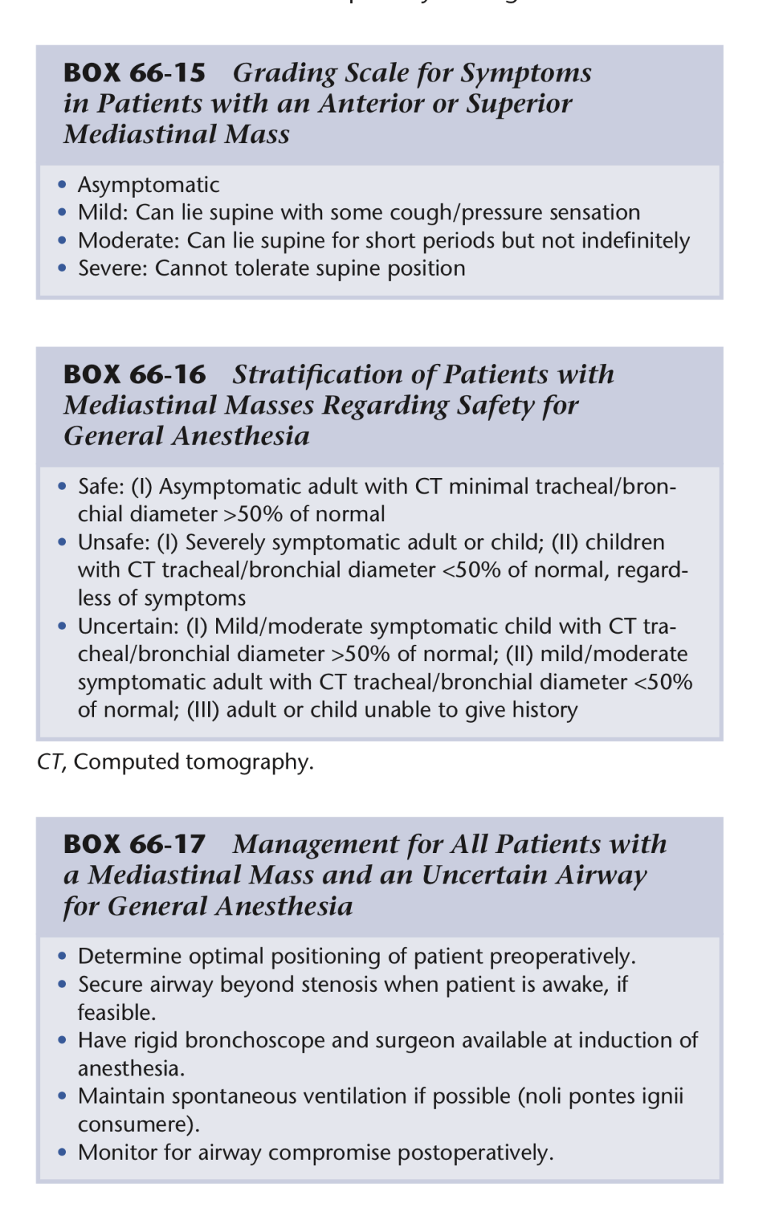

Slide 50
In OR 0900
Monitor V/S
BP 100/64 mmHg PR 65/min
O₂sat 96% RA
A line At Lt.RA under LA

Slide 51
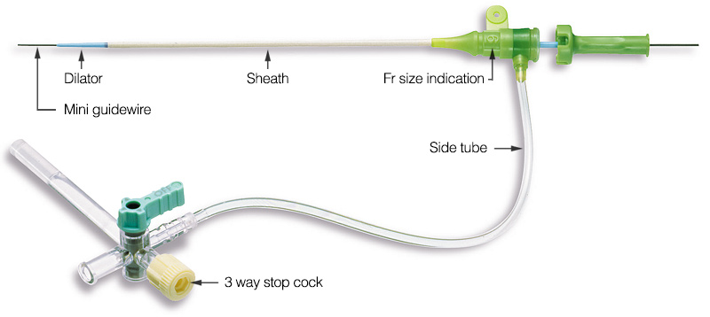
Insert sheat 8 Fr at Rt. Femoral vein

Slide 52
0910
Preoxygenation
Induction
Propofol 100 mg
Cisatracurium 8 mg
Intubation
ETT no. 7.5 depth 22 cm LV gr.1
Maintenance
N₂O:O₂ = 1:1 , Sevoflurane 2 %

Slide 53
IV access
No 22 G at Lt. leg จาก ward
Large bore IV at lower extremities ?

Slide 54
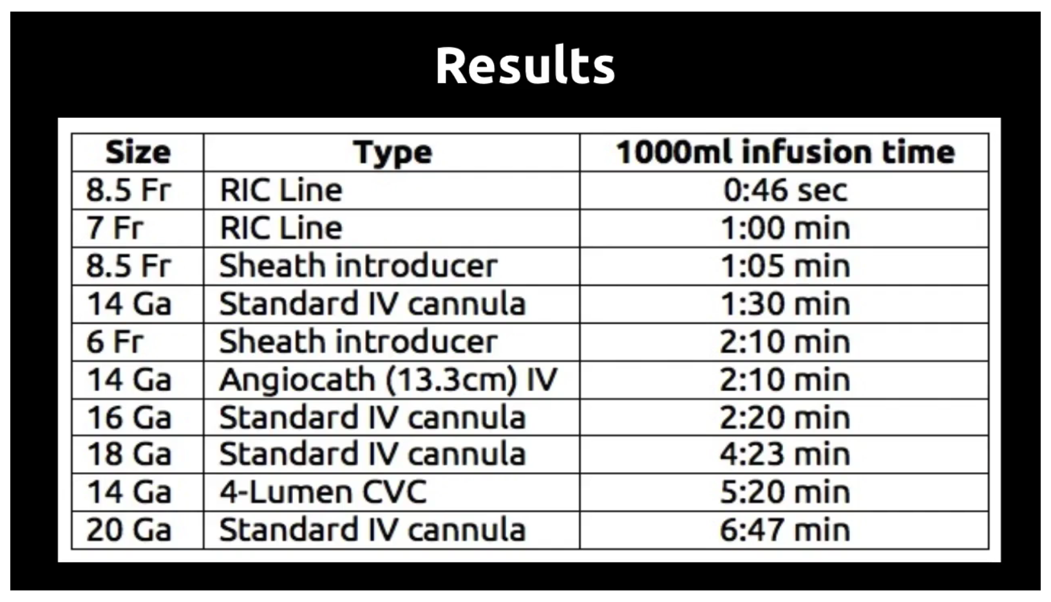

Slide 55
ATB Cefazolin 1 gm at 0945
ABG
pH 7.46 pO₂ 165 paCO₂ 34 HCO 23.6 BE 0.2
DTX 177 mg% Hct 36%
Start operation at 1020

Slide 56
Intraoperative
Maintaining the least symptomatic position during induction
Induction at semi-upright position
Using induction agents that have minimal effects on hemodynamics
Optimizing volume status
Urine output,PPV
Continuous communication with the surgical team
ensure their awareness of the severity of hemodynamic changes occurring during manipulation or due to blood loss

Slide 57
R3 Emergence ?
Notes:
Postoperative pulmonary complication 11%
Risk
Preoperative cardiorespiratory signs and symptoms
Obstructive or restrictive dysfunction on PFT
Greater than 50% tracheal compression on CT scan

Slide 58
Emergence
Smooth emergence
Awake extubation
Notes:
After extubation, supplemental oxygen

Slide 59
Emergence
TOF = 100%
extubation

Slide 60
End operation 1415
Operative time 5 hr 15 min
Opioids
Fentanyl 200 mcg
Morphine 10 mg
I/O
Acetar 1950 ml + NSS 3000 ml
PRC 2 U = 564 ml
Urine output 950 ml
Blood loss 1000 ml

Slide 61
Post operative management
Aware
Hemorrhage
Airway compromise
Pain control
Glycemic control

Slide 62
Post Operative Day 1
S : ตื่นดี มีหายใจเหนื่อย ไม่มีปวดแผล ไม่มี N/V
O : BP 132/70 mmHg PR 120 BPM
BT 37.4°C RR 24 breaths /min
Lungs : clear both lungs , use of accessory muscle
A + P
S/P Median sternotomy with tumor removal
NPO
Pain control : Fentanyl 50 mcg prn q 1 hr, Dynastat 40 mg
Dyspnea
Supporttive Rx -> On ETT
DM
GIK 60 ml/hr

Slide 63
Post Operative Day 2
S : ตื่นดี หายใจตามเครื่อง ไม่มีปวดแผล ไม่มี N/V
O : BP 108/55 mmHg PR 90 BPM
BT 36.4°C RR 22 breaths /min
Lungs : Rhonchi both lungs
A + P
S/P Median sternotomy with tumor removal
Pain control : Paracetamol 500 2x4 opc
Respiratory failure
On ventilator SIMV RR 6 PS 12 Fio2 0.4
CVT R/O phrenic nerve injury
DM
BD (1:1) 100 ml x feed
HR (1:1) V 4 ml/hr DTX 180-230 mg%

Slide 64
Post Operative Day 3
S : ตื่นดี หายใจตามเครื่อง ไม่มีปวดแผล ไม่มี N/V
O : BP 104/83 mmHg PR 84 BPM
BT 36.3°C RR 20 breaths /min
Lungs : minimal Rhonchi both lungs
A + P
S/P Median sternotomy with tumor removal
Pain control : Paracetamol 500 2x4 opc
Respiratory failure
On ventilator CPAP PEEP5 PS 10 Fio2 0.3
DM
BD (1:1) 100 ml x feed
HR (1:1) V 1.5 ml/hr DTX 170-200 mg%

Slide 65
Post Operative Day 5
S : ตื่นดี มีหายใจเหนื่อย ไม่มีปวดแผล ไม่มี N/V
O : BP 100/55 mmHg PR 90 BPM
BT 36.4°C RR 18 breaths /min
Lungs : clear both lungs , use of accessory muscle
A + P
S/P Median sternotomy with tumor removal
Respiratory failure
Try waen off ETT
On BIPAP
DM
DTX 150 -200 mg%

Slide 66
Progress
ผล patho
Diffuse large B cell lymphoma
Med R/O Wolfran syndrome(DIDDMOAD)
DI -> pt เคยมี Hx DI
DM -> pt เป็น type I DM
OA -> optic disc atrophy
D -> deafness -> SNHL

Slide 67
Progress
ญาติขอ refer ไปทำการรักษาต่อที่ รพ. จุฬา

